Slide 1
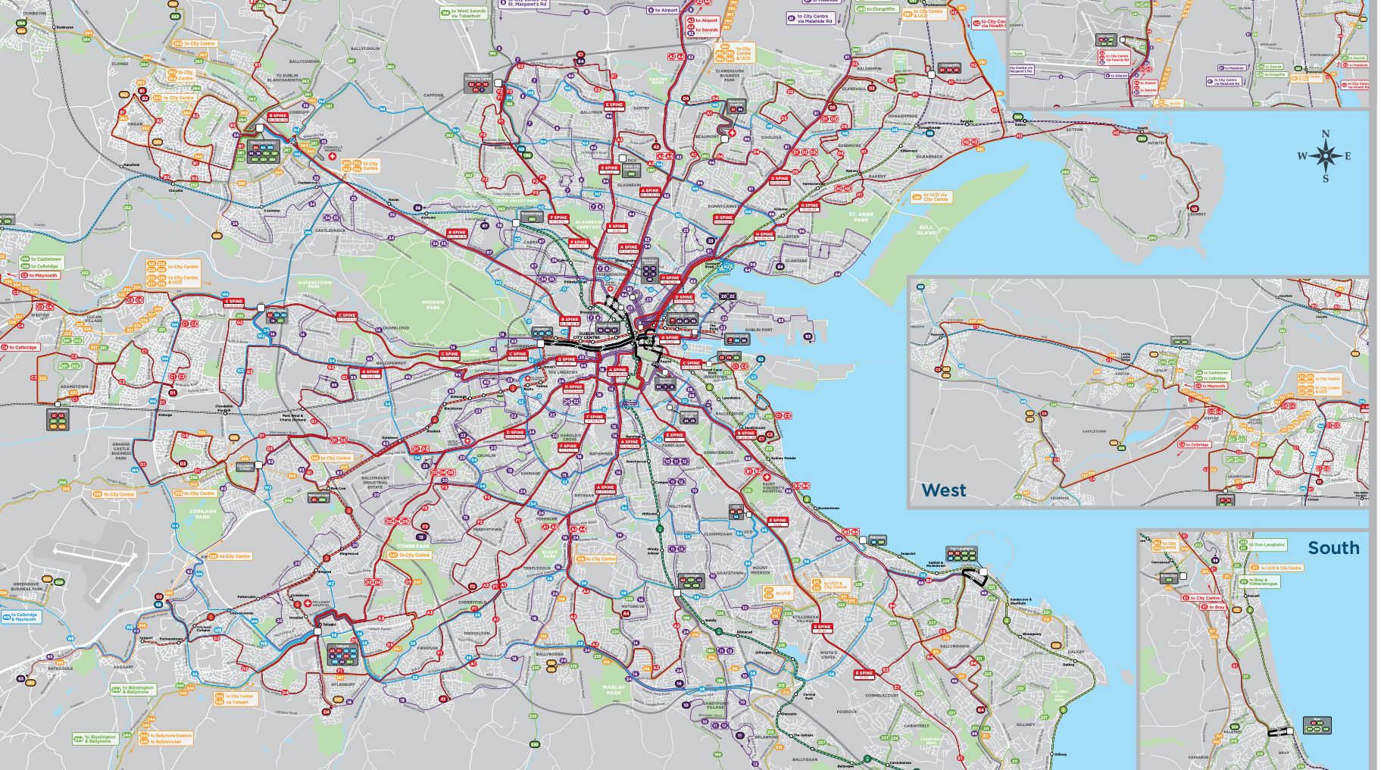
INITIAL BIG PICTURE
16th June 2021
Fig. 1: Dublin Bus Network (BusConnect)
Team 10 - Team Members:
Daniel Danev – Code Lead
Danning Zhan – Maintenance Lead
Turlough Hannon – Coordination Lead
Adam Ryan – Customer Lead

Slide 2
1. INTRODUCTION
Analyse bus and weather data to create dynamic time estimates.
Complete route and sections of the route.
User-focused design delivered via web app (mobile optimised).
The design should be easy to use with all relevant information.
Innovative Features
The app should incorporate novel features beyond the brief.

Slide 3
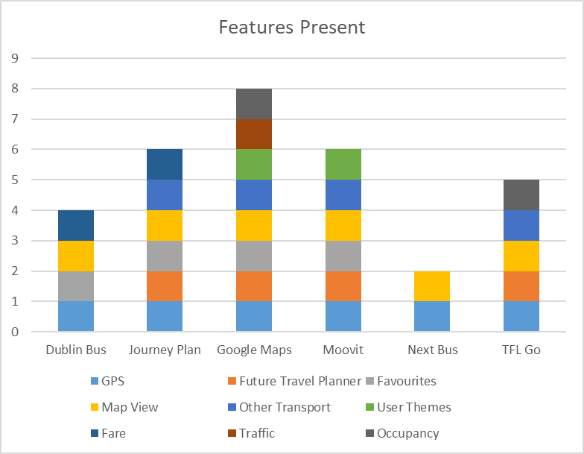
2. EXISTING SOLUTIONS
Common Features
Geolocation.
Real Time Planning and Future Scheduling.
Map Views and Text Views.
App in addition to Browser.
Favourite Routes and Locations.
Adding travel to Calendar.
Multiple Transportation Systems.
Luas, Bike, Walk, Car.
Existing travel apps have varied user experiences receiving mixed responses.
UX issues.
Travel time is real time info - Inaccurate for future journeys.
Fig. 2: Feature Presence across iOS app by inspection

Slide 4
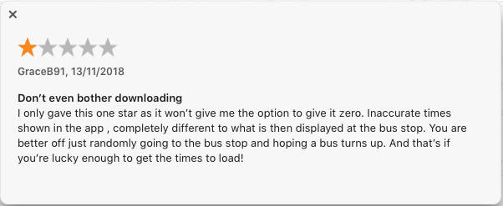
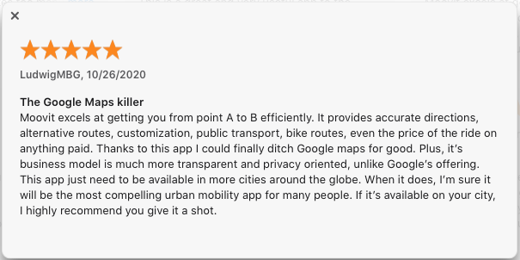
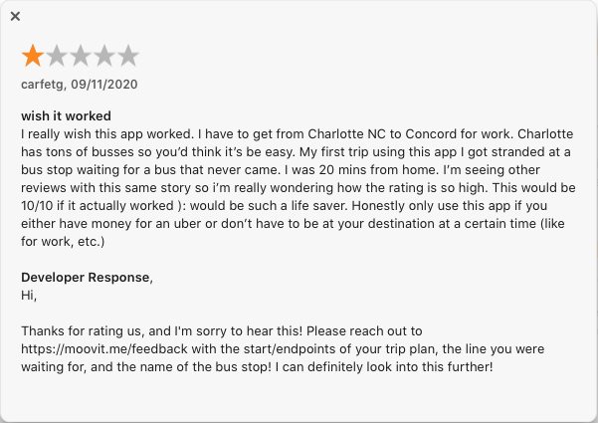
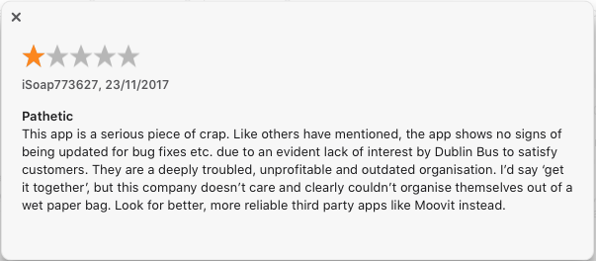
2. EXISTING SOLUTIONS
Dublin Bus - 1.9 out of 5.
Moovit - 4.7 out of 5.
Fig. 3/4: Dublin Bus iOS App Reviews.
Fig. 5/6: Moovit iOS App Reviews
*Ratings Per iOS App Store Feedback as of 15th June 2021
Notes:
Transport for London - Respond to Positive Feedback Only
Moovit - Both

Slide 5
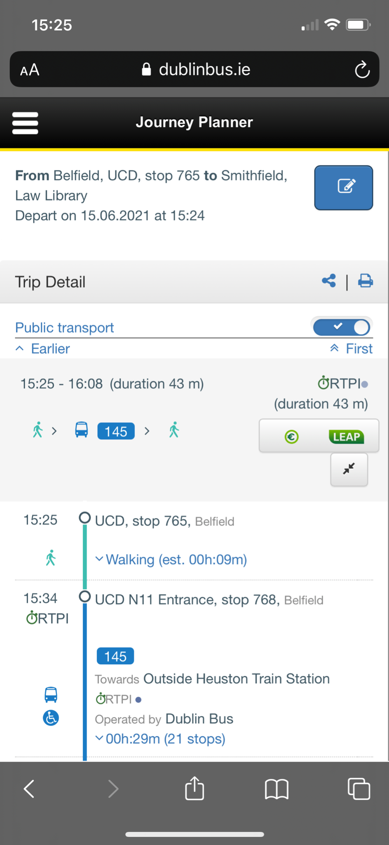
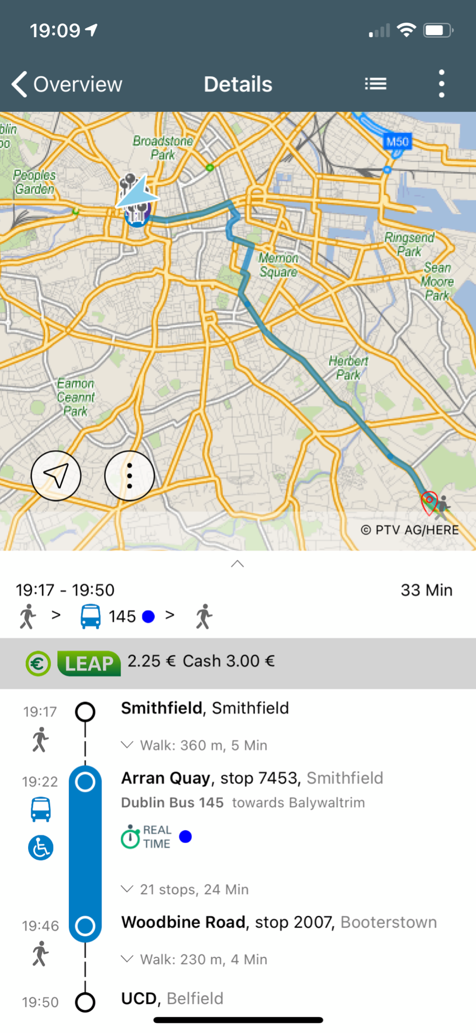
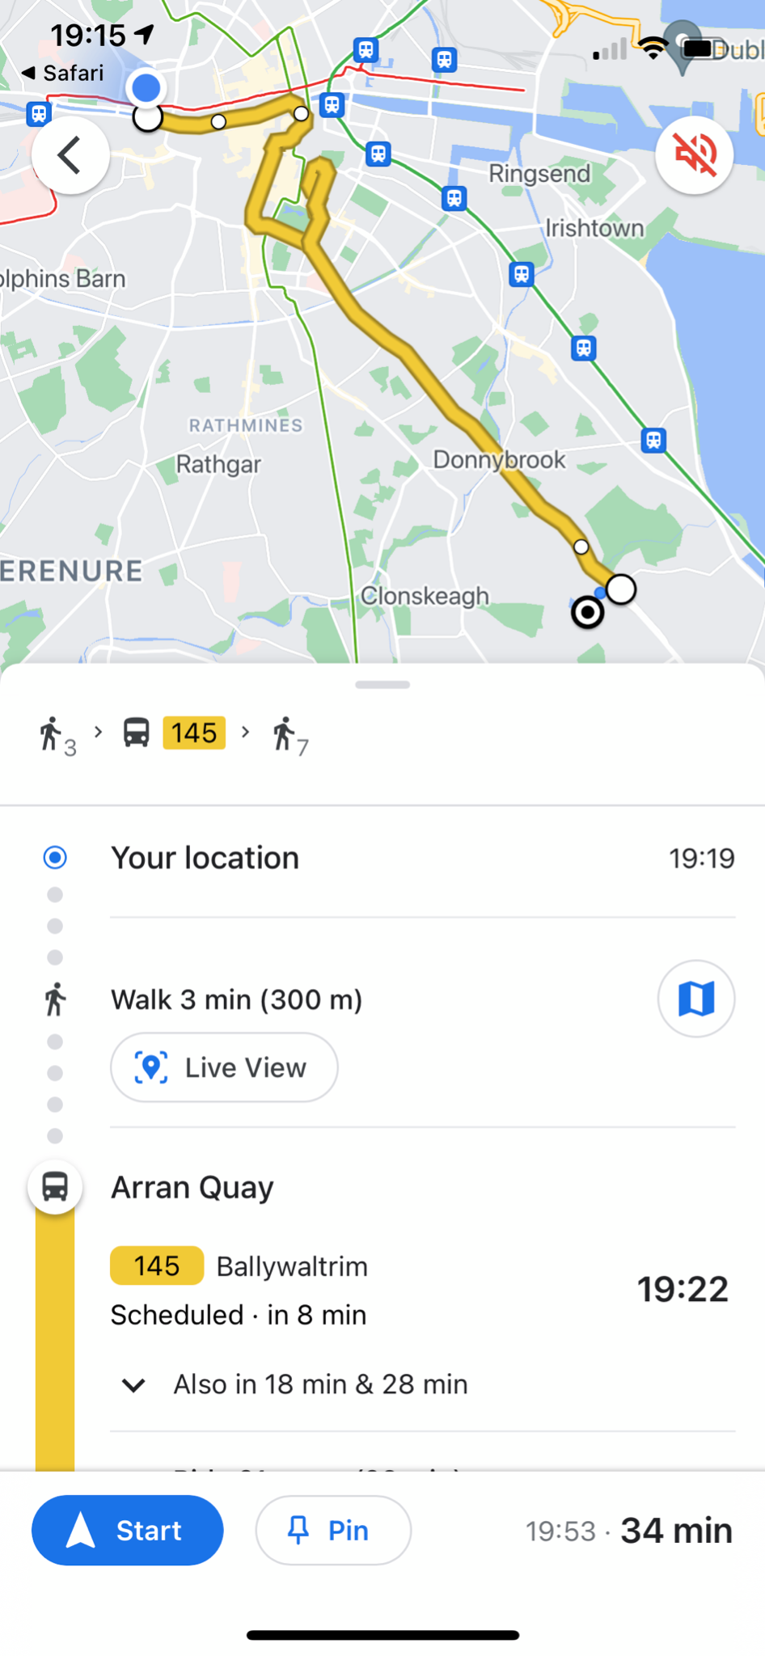
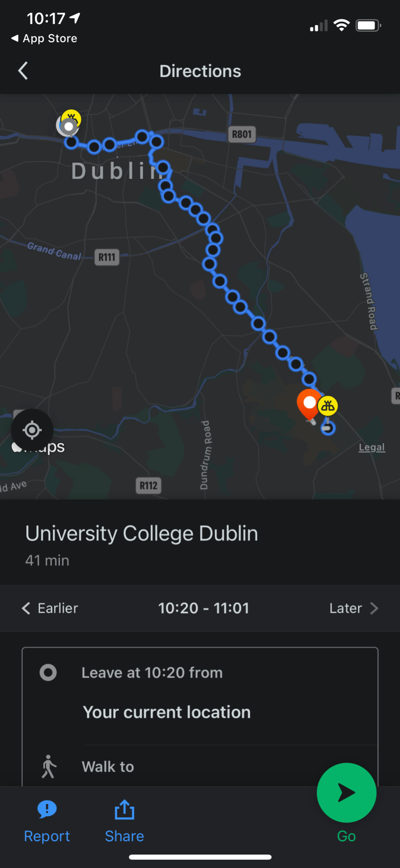
2. EXISTING SOLUTIONS
Dublin Bus
TFI - Journey Plan
Google Maps
Moovit
Fig. 7: Dublin Bus Mobile Browser
Fig. 8: TFI App
Fig. 9: Google Maps App
Fig. 10: Moovit App

Slide 6
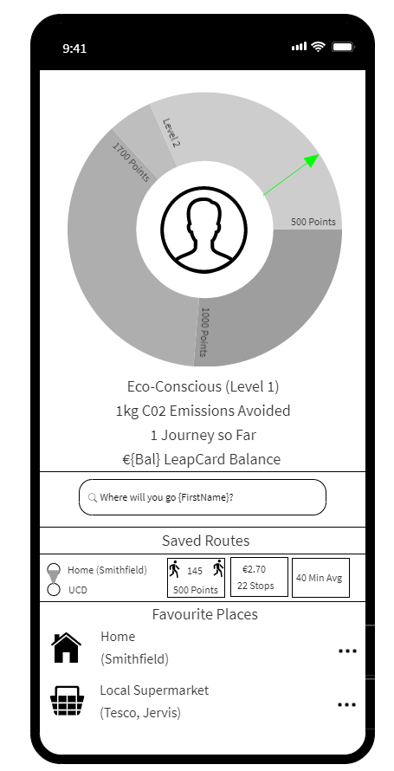
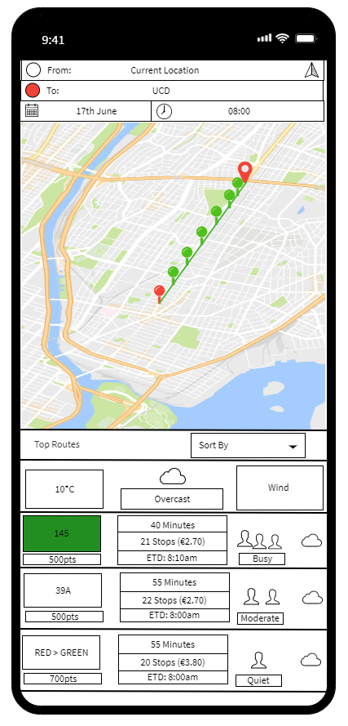
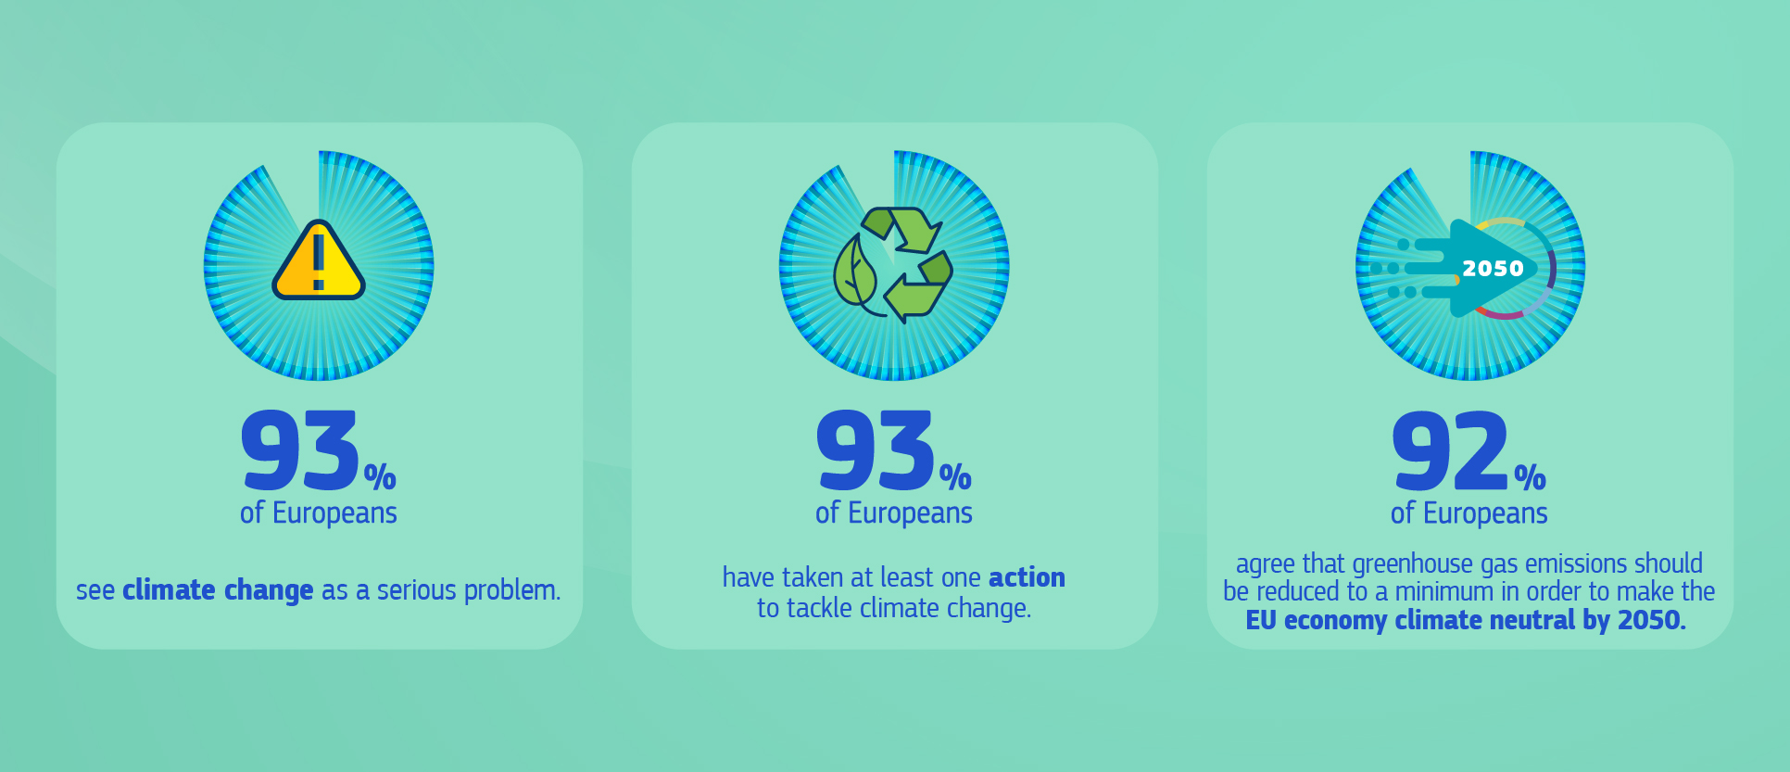
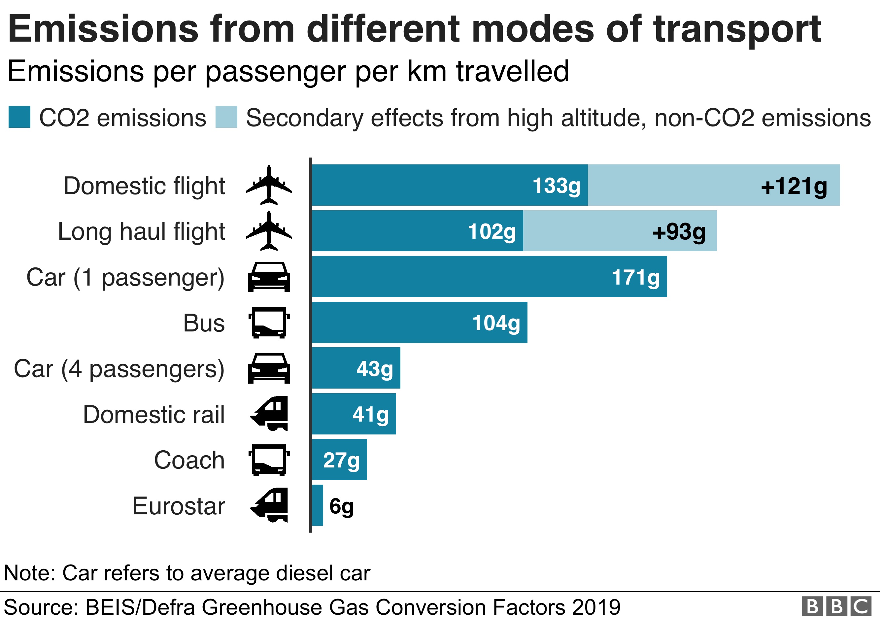
3. OUR BIG IDEA
User-feedback driven design.
Accurate travel predictions with weather and traffic info.
Incorporate features of well-received apps.
Traffic Info (Google Maps API).
Feedback Acquisition (in-app).
Account Management (user)
Bus Occupancy (user feedback).
Alternative Transport Methods (TFI API).
New Innovations
Sustainability Focus.
Future weather highlighting.
Fare and Leapcard Data.
Popular Routes and Route Sharing.
Business Intelligence Incorporation (Google Analytics).
Fig. 11: Wireframe 1
Fig. 12: Wireframe 2
Fig. 13: EU Climate Opinion (EU Commission)
Fig. 14: Transport Emissions (BBC)
Notes:
We can implement user testing for continuous improvement, see how the application fares in the real world.
Modern designs shouldn’t feel disjointed

Slide 7

4. GUIDING PRINCIPLES & FULFILLMENT MECHANISMS
All made possible by modern software development tools, technologies and methods:
Version Control and Repositories (GitHub/GitLab)
Develop (with branches) > Release > Production.
Modern Tech Stack and Architecture
Django, MySQL, React, D3.js, to be confirmed
Project management and Agile development
Github, Jira, Confluence.
Data Sources
Google Maps API
TFI API
OpenWeatherMap & MET
User submission
Leapcard (pyleapcard)
Fig. 15: GitFlow (Vincent Driessen). Release corresponds to UAT

Slide 8
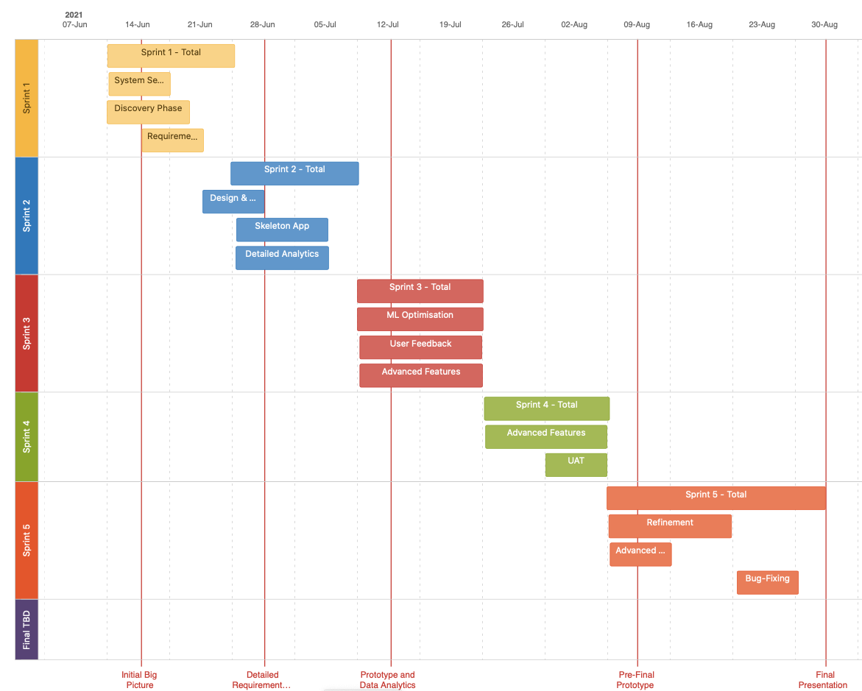
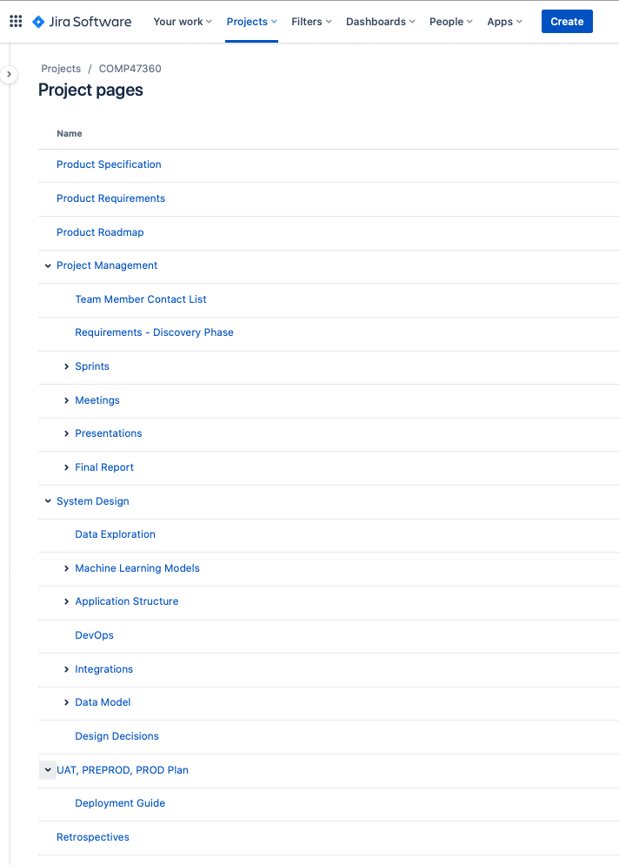
5. PROJECT ROADMAP & MANAGEMENT STRATEGIES
Agile Structure
Five Sprints.
Goals in Development.
User guidance in Sprint 2-5.
Documentation and Communication
Jira.
Confluence.
Meetings
Daily Check-ins.
Weekly Review.
Role Distribution
Focused areas
Broad exposure to all.
Fig. 16: Initial Sprint Plan (in development)
Fig. 17: Confluence Structure

Slide 9

6. Questions and Answers
“Every single full bus replaces the equivalent of 80 cars on our roads, reducing emissions by over 90% and freeing up 300 metres of roadway” – DublinBus in Our Journey to Zero
Thank you for your time, and attention, and we would welcome any questions

